Slide 1


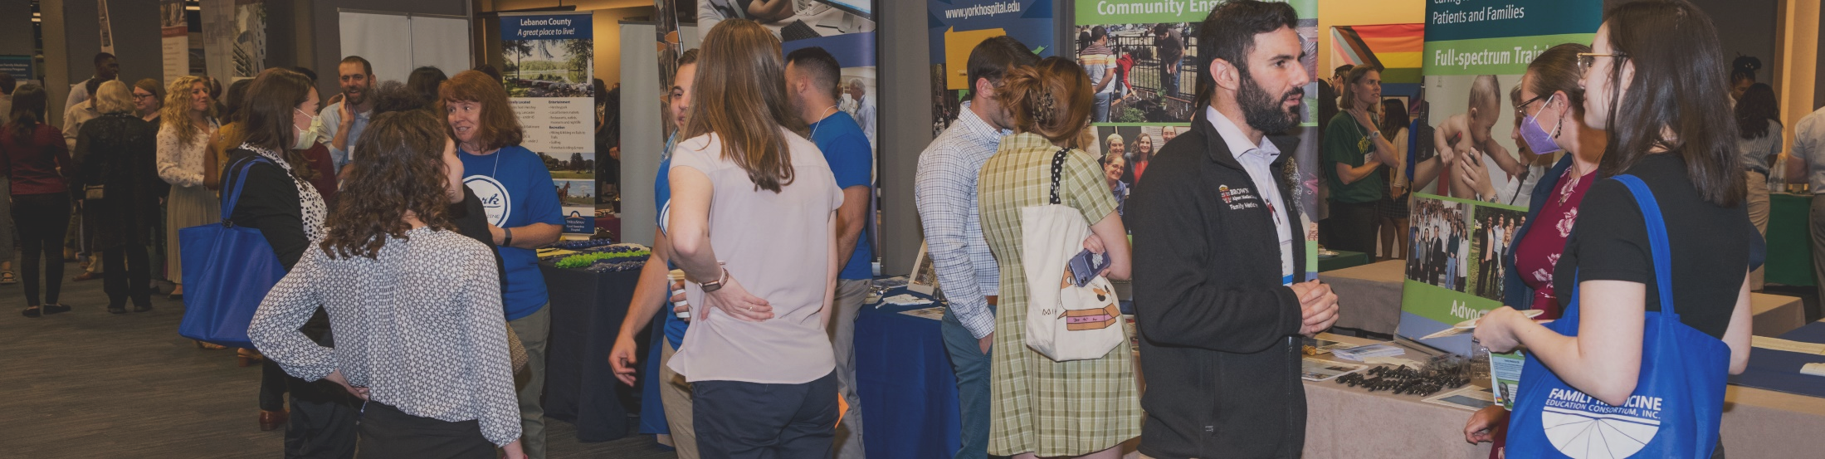
Virtual Orientation to the FMEC Annual Meeting
for Scholarship Attendees
September 28, 2023
www.fmec.net
Notes:
Scott

Slide 2

Please introduce yourself in the chat!
Use the chat or unmute yourself to ask questions or answer our questions
Please mute when you are not speaking
www.fmec.net
Notes:
Scott

Slide 3
What is the FMEC?
About the Family Medicine Education Consortium
The FMEC is a catalyst, convener, and incubator that connects family physicians and other stakeholders to improve the health communities by strengthening family medicine, primary care and medical education. The FMEC serves 14 states and the District of Columbia in the northeast region of the U.S., working with 60 medical school departments of family medicine, 190 family medicine residency programs, and thousands of family physicians and other health care providers in community settings.
Through an Annual Meeting for nearly 1,000 health professionals, annual awards, learning communities, and quality improvement projects,
the FMEC inspires medical students to seek careers in family medicine, strengthens academic family medicine through faculty development
and leadership experiences, and stimulates innovative approaches to primary care service delivery.
www.fmec.net
Notes:
Scott

Slide 4

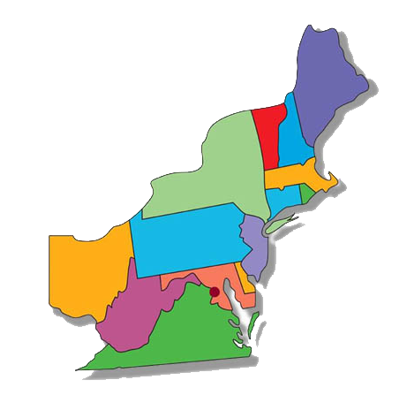
Where do we serve?
FMEC Goals
  Promote family medicine and primary care to students
  Support residents as they transition in their careers
  Strengthen academic family medicine
  Create and sustain quality improvement initiatives
  Stimulate innovative approaches to primary care service delivery
www.fmec.net
Notes:
Scott

Slide 5
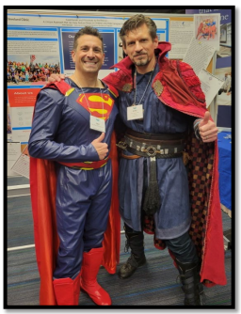
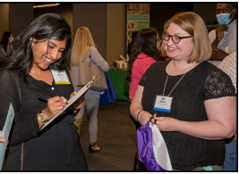
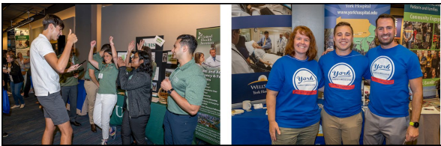
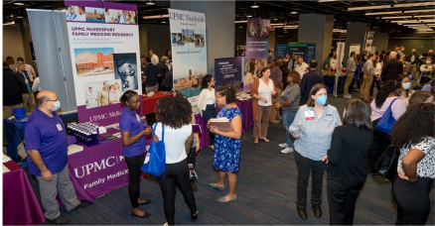
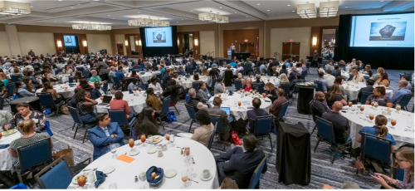
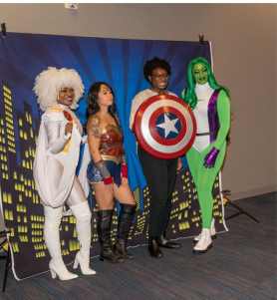
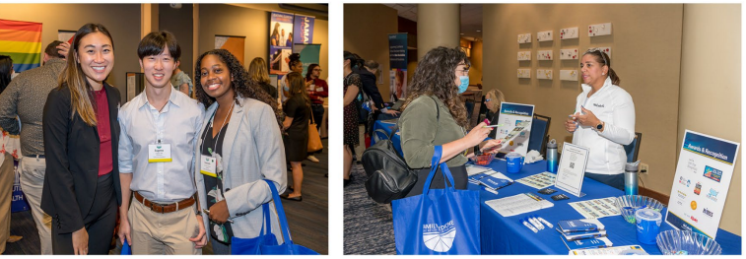
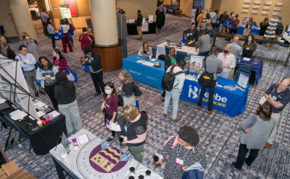
www.fmec.net
Notes:
Scott

Slide 6

What does your scholarship cover?
Your scholarship includes:
FMEC membership for one year
Annual Meeting registration fee
All conference-provided meals and breaks
Two (2) nights in the hotel (double bedded room shared with another scholarship student)
Admittance to Residency Fair and all academic programming
One-on-one support from the FMEC Student Coordinator
A pre-meeting orientation and Q&A session to prepare you for the meeting
Travel to the conference and parking are not covered.
Incidentals are not covered.
www.fmec.net
Notes:
Jen

Slide 7
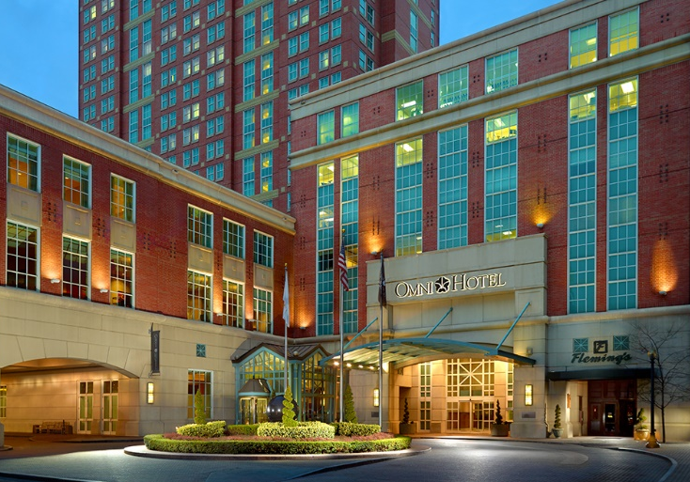
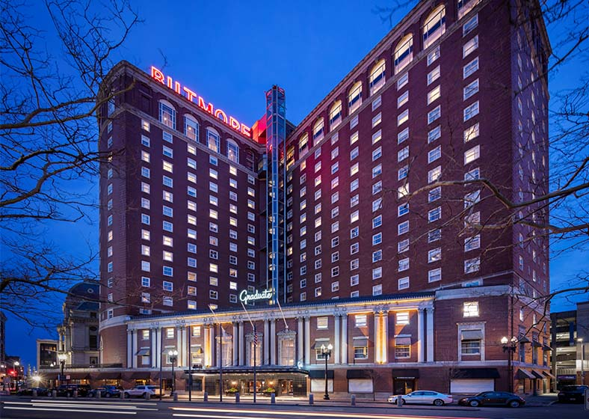
Which hotels have FMEC Student Blocks?
Omni Providence Hotel
1 West Exchange Street Providence, RI 02903
Graduate Providence Hotel
11 Dorrance Street
Providence, RI 02903
Your scholarship confirmation letter stated which hotel you are staying in.
If you have any questions, please contact Jennifer Stamper:
jennifer.stamper@fmec.net
www.fmec.net
Notes:
Jen

Slide 8
Navigating the FMEC Annual Meeting
Schedule at a Glance
FRIDAY, OCTOBER 13
7:00 am - 8:30 pm Registration
8:00 am - 12:00 pm Preconferences
10:00 am - 1:00 pm Residency Fair Set-up
11:00 am - 3:00 pm Welcome Lounge
3:00 pm - 5:30 pm Exhibitor Booth Hours
1:00 pm - 4:45 pm Academic Presentations
3:15 pm - 3:45 pm Afternoon Break (visit the exhibits)
4:45 pm - 5:30 pm Evening Break (visit the exhibits)
5:30 pm - 7:00 pm Welcome, Dinner, Awards, Plenary
7:00 pm - 9:00 pm Residency Fair
SATURDAY, OCTOBER 13
7:00 am - 7:45 am Breakfast Table Discussions
7:45 am - 9:15 am Welcome, Awards and Plenary 9:00 am - 5:00 pm Exhibitor Booth Hours
9:15 am - 9:45 am Morning Break (visit the exhibits) 9:45 am - 12:00 pm Academic Presentations
12:00 pm - 2:00 pm Poster Sessions #1 and #2, Clinical Camp Sessions, Visit Exhibits, Lunch
2:00 pm - 4:15 pm Academic Presentations
4:15 pm - 4:45 pm Afternoon Break (visit exhibits)
4:45 pm - 6:45 pm Residency Fair
SUNDAY, OCTOBER 15
7:30 am Breakfast
7:30 am - 9:00 am Welcome, Awards and Plenary
9:00 am - 12:30 pm Academic Presentations
12:30 pm Conference Concludes
www.fmec.net
Notes:
Jen

Slide 9
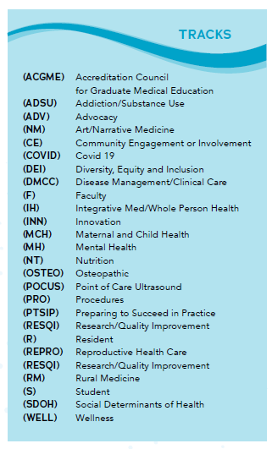
Navigating the FMEC Annual Meeting
Educational Programming:
Workshops and Seminars are 1 hour.
(some may be 90 minutes)
Research and QI = 30 mins (2 per 1-hour block)
Lecture Discussions = 20 mins (3 per 1-hour block)
Papers = 15 mins (4 per 1-hour block)
Clinical Success Stories, Power Stories,
Speed Presentations = 5-7 mins
www.fmec.net
Notes:
Scott

Slide 10


Plan your schedule in advance!
To download the mobile app, search the App Store
or Google Play for “FMEC”.
Login: the email address you used for registration
Password: fmec2023
With the mobile app, you can:
• Stay organized with real-time event information
• Receive on-site messages from FMEC
• Build a personalized schedule
• Search by day, track or speaker name
• Take notes and download event handouts and presentations
• Rate the sessions you attend and add comments
• Find attendees and connect with your colleagues through Friends
• Share your event photos and experiences with the Activity Feed
• And much, much more!
www.fmec.net
Notes:
Scott

Slide 11
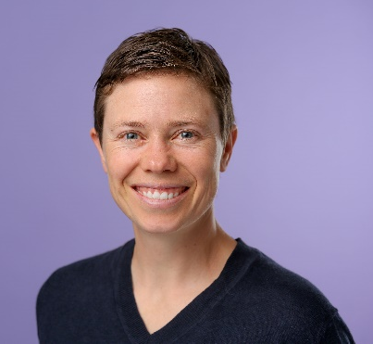
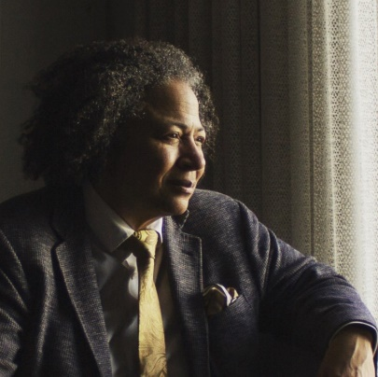
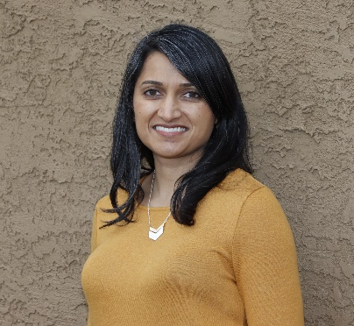
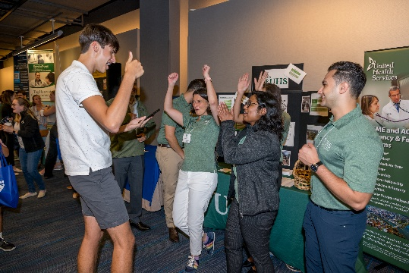
Can’t Miss Events
Friday Plenary
October 13th, 5:30 pm
Saturday Plenary
October 14th, 7:45 am
Sunday Plenary
October 15th, 7:30 am
Izzy Lowell, MD
Transgender Healthcare
Renee Crichlow, MD
We Got This Family Medicine
Manisha Kumar, MD
Catalyst for Change:
Increasing Access to Safe Abortion Care
and Upholding Bodily Autonomy
Two opportunities to visit the Residency Fair!
Friday, October 13: 7pm-9pm (after plenary speaker and dinner)
Saturday, October 14: 4:45pm-6:45pm (then free night!)
www.fmec.net
Notes:
Scott

Slide 12
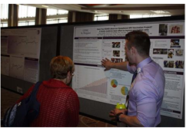
If you are presenting a poster:
Poster set-up time: Saturday morning from 10:30 am – 12:00 noon.
Where: Exhibition Hall Prefunction, 3rd Floor
Poster Session I: Saturday, 12:00 pm – 12:45 pm
Poster Session II: Saturday, 1:15 pm – 2:00 pm
Presenters must bring their own poster supplies, such as poster, push pins, scissors, tape, etc.
Poster tear-down is Saturday afternoon no later than 2:30 pm.
Poster presentation area is a 4 X 8 cork-board surface mounted on an easel. Each easel is numbered; refer to the Conference Program to find your poster number.
Session I presenters: please wrap up so Session II can put posters up.
Watch the recorded Zoom meeting about presenting a poster (see the FMEC website).
www.fmec.net
Notes:
Scott

Slide 13
Things to know…
REGISTRATION opens at 8:00am on Friday, October 13th
HOTEL CHECK-IN is 4:00pm but you can check to see if your room is ready early. If you requested housing, you do not need a confirmation number to check into the hotel. Your name is on our student rooming block list. Go to the hotel check-in desk and give them your name. A credit card is required to secure any incidentals you may incur, but the lodging costs are on our master bill.
IMPORTANT: Please be aware: Your roommate may not check in until Saturday. All rooms have at least 2 students in them unless there are last minute cancellations. If you have secured a private room, this does not apply to you.
LUGGAGE - If your room is not ready, please do not bring your luggage into the programs, but rather check it at the front desk of your hotel (either at the OMNI or The Graduate)
www.fmec.net
Notes:
Jen

Slide 14
Things to know…
THURSDAY NIGHT STAYS - These are not covered by your scholarship award. If you contact the hotel directly for a Thursday night stay, this will be at your cost.
PARKING is not covered by your scholarship.
DRESS IS BUSINESS CASUAL - wear comfortable shoes! You will be doing a lot of walking.
BE FLEXIBLE! Opportunities to network with other physicians from the meeting are invaluable. Don't be afraid to sit and chat between sessions during these chance encounters.
STUDENTS OF ALL YEARS are welcome to attend any session! Sessions coded as (S) are especially for student audiences.
THE RESIDENCY FAIR happens on both Friday (evening) and Saturday (late afternoon).
www.fmec.net
Notes:
Jen

Slide 15
Which programs will be represented
at the Residency Fair?
For a full list of the programs, visit the conference app and look at show documents. There is also a listing in the printed program.
Door Prizes each night:
  Each scholarship student will receive a door prize card for each night of the residency fair. If you have 5 programs sign your card during the event, you can drop your completed entry into the bins for the chance to win some great prizes!
Which questions should you be asking?
How can you make the most of your time there?
www.fmec.net
Notes:
Scott

Slide 16
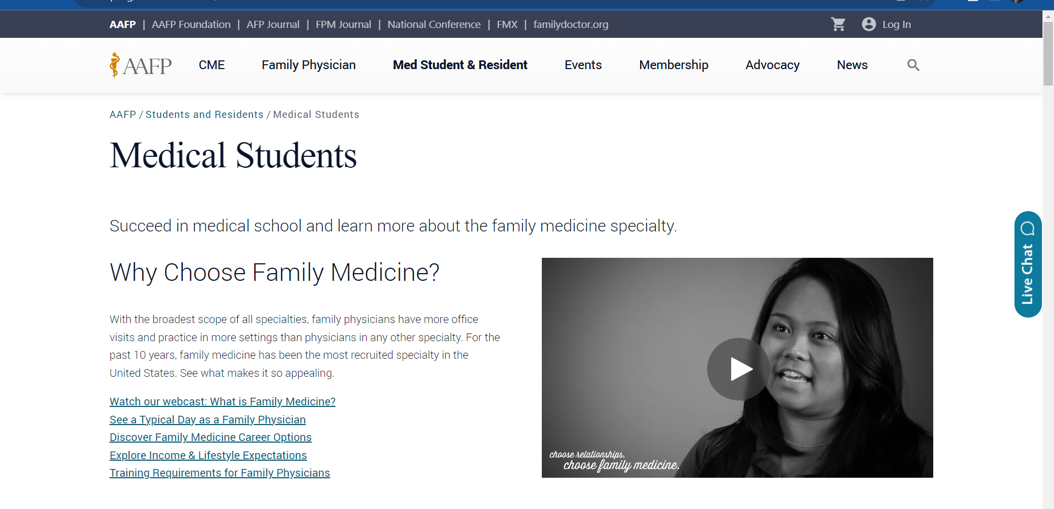
Resources from the AAFP
https://www.aafp.org/students-residents/medical-students.html
www.fmec.net
Notes:
Scott

Slide 17
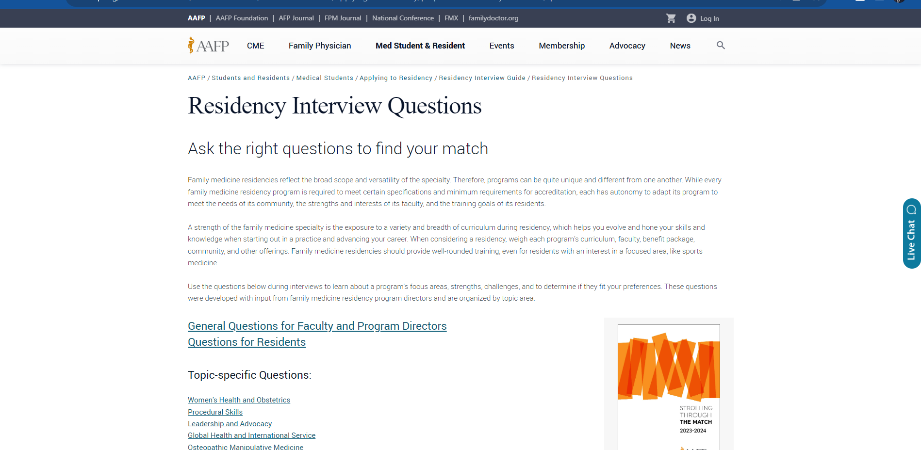
Resources from the AAFP
https://www.aafp.org/students-residents/medical-students/become-a-resident/applying-to-residency/prepare-for-residency-interviews/questions.html
www.fmec.net
Notes:
Scott

Slide 18
Resources from the AAFP
General Questions for Faculty and Program Directors
Where are most graduates located?
What types of practices do graduates go into after residency?
How do you perceive your program compared to other programs?
What are the program’s strengths? What makes your program unique?
What kind of feedback have graduates given you about your program?
Questions for Residents
What was the most important factor that made you choose this program?
What is a typical week/month/year like for a resident in PGY-1, PGY-2, and PGY-3?
What is call like? What kind of backup and supervision is provided?
When leave of absence becomes necessary, what happens?
What community service opportunities are available?
Women’s Health and Obstetrics
Which obstetric procedures are available in the program?
What are the learning processes for training in obstetrics (OB)? Which faculty teach obstetrics?
Procedural Skills
Could you describe your curriculum as it relates to procedural skills in family medicine? Which procedural skills training does the program offer?
What is your philosophy regarding procedural skills in family medicine?
How do residents get exposure and training in procedural skills?
Leadership and Advocacy
Does the program have leadership curriculum?
Are residents supported in external and/or organizational activities?
Global Health and International Service
What is the goal of the international rotation?
Can you describe the field experience (e.g., clinical activities, public health initiatives, community activities, patient education, or other activities)?
What is the cost of international experiences to residents?
Osteopathic Manipulative Medicine
Underserved Populations/SDOH
Anti-Racism, Diversity, Inclusion
Fellowships
Academic or Research Careers
Sports Medicine
Integrative Medicine
Well-Being and Culture
www.fmec.net
Notes:
Scott

Slide 19

What should you do onsite if you have questions or problems
  Please come to the FMEC Registration desk located on the third floor
  (Exhibit Level) of the convention center.
What will happen after the meeting?
  You will be asked to write up (briefly) your experience to share with our donors.
  Your scholarship comes with an annual student membership to the FMEC.
  You will receive communications throughout the year to stay in touch with us!
How can you stay connected to family medicine?
  Connect with the FMIG at your school, if possible.
  Join the AAFP as a student member!
www.fmec.net
Notes:
Jen

Slide 20


GoProvidence.com helps you prepare
for the FMEC Annual Meeting
Questions about Providence, RI? The GoProvidence team is standing by to help you prepare for your visit and ensure a successful stay. Email them anytime at CFoto@GoProvidence.com with all your destination questions.
Whether you're bringing your family, are looking for restaurant recommendations with your colleagues, or have an hour of free time, we can recommend some of our favorite spots. Once you're in town, be sure to stop by the Visitor Information Center, conveniently located on the ground floor of the Rhode Island Convention Center.
The FMEC thanks GoProvidence and our expert helper Carley Foto!
www.fmec.net
Notes:
Jen and Scott

Slide 21

Questions about the FMEC or the Meeting?
www.fmec.net
Notes:
Jen and Scott

